Slide 1
GlyCompare
Bokan, Ben

Slide 2
Compare the glycoprofile
Comparing the glycoprofile is important. It tells us how glycan synthesis process is regulated or influenced by the genome modification. Difference, substructre(motif), synthesis perturbation.
Reading glycoprofile is hard. Each glycoprofile has multiple glycan structures and each glycan structure has overlapping chemical structure.
Comparing glycoprofile is even harder. Because each glycoprofile has different glycans, you cannot directly compare them.
Notes:
You have monitor

Slide 3
3 Result
Glycoprofile deconvolution and cross-profile comparison
The glycans in a glycoprofile were annotated and their abundance were calculated. The glycans were destructed and represented by a ‘substructure vector’ (Figure 1a). Then, a glycoprofile consisting of multiple glycans was transformed to ‘glycoprofile vector’ by summing a set of weighted motif vector (Firgure 1b). Then, a substructure network is built to remove the nodes that will not contain more information (Figure 1c and 1d) and the nodes that contain the most valuable information are selected for glycoprofiles’ classification.

Slide 4
Figure1 Working pipeline
Redundant cluster map
Simplified cluster map
Glycoprofile Vector
Matched Vector
Motif Vector

Slide 5
A
B

Slide 6
2 Result
A comprehensive knockout screen of glycosyltransferases genes controlling N-glycosylation in CHO cells has been performed(Yang et al. 2015). In this study, 37 glycoprofiles of N-glycosylation of human erythropoietin (EPO, having three N-glycans with heterogeneous tetra-antennary structures, low poly-LacNAc and α2,3-linked sialic acid capping) was characterized by MALDI-TOF (matrix-assisted laser desorption/ionization–time of flight) profiling of released permethylated N-glycans using literature data to interpret and annotate structures. Then, on the following study, the high-resolution native mass spectrum glycoproteoform profile is used to classify the similarities on 23 glycosylation profiles about EPO (Čaval et al. 2018). Since these two studies shares 16 same knockouts, these 16 glycoprofiles with abundance and structure annotation are curated. The cell lines include the single or joint knockout targeting galactosylation (b4galt1/2/3/4), sialyation capping (st3gal4/6), N-glycan branching (mgat1/2/4A/4B/5) and core \alpha 6-fucosylation(Yang et al. 2015). The classification by Glycompare is compared with the result from native mass spectrum (Čaval et al. 2018) and also compare with the classification by complete glycostructure.

Slide 7
Result 2.1 Clustering of 16 glycoprofiles
Figure 2A
First, a glycoprofile vector with 722 glycan substructure are generated and then reduced to 118 glycan substructures. The cluster map (Figure2 A) shows the glycoprofile are classified based on the complexity of the N-glycan structure preserved. Each cluster has distinguished glycan structure patterns. The mild group that contains WT also has b4galt1/2/3/4/ knockout. The medium group contains mainly magt4b/4a&4a/5 knockout and st3gal4/6 knockout. A severer group that contains joint knockouts of st3gal4/6 and mgat4a/4b/5, knockouts of mgat4A/4B/5 and b3gnt2, knockouts of mgat4A/4B/5 and knock-in of st3gal6, knockouts of mgat4a/4b/5 and st3gal4/6. The severest groups have glycoprofiles with Fuc 8, mgat2, mgat 1 knockout. It means these three glycoprofiles have major different glycol-substructures.
The clustering with annotated glycan is bad because there are only a few glycans.
Notes:
we cluster the glycoprofiles with the glycans whose relative abundance are larger than 1% in each glycoprofile(Figure2 B).

Slide 8
Figure 2B/Figure2C
Second, the classification of the glycoprofiles by the glycans are shown. (Figure2 C). Since the glycans with minor variant are considered as two glycans, the structural differences of the glycan in each knockout causes the sparsity of the glycan table which jeopardized the classification. The cluster is mainly based on the existence of the glycans and the distances between profiles are not well linearly characterized. The cluster is not consistent with the NCM and our result.
Third, the classifiation result is consistent with the classification by the glycoproteoform native mass spectrum data. The disagreement comes with the rearrange of the knockouts of mgat2 and the knockouts of fu8. Since our method takes care of the structure difference across isomers. We can distinguish the different structures that has same mass and the variation of structures that effect lots of substructures. Thus, we have a better interpretation of the glycan structure variants across multiple glycoprofile.

Slide 9
A
B
KO_mgat1
KO_mgat2
KO_fut8
KI_st3gal6; KO_mgat4a/4b/5_st3gal4/6
KO_mgat4A/4B/5_B3gnt2
KO_st3gal4/6_mgat4a/4b/5
KO_mgat4A/4B/5
KO_mgat5
KO_mgat4A/4B
KO_mgat4B
KO_st3gal4/6
KO_B4GalT1
KO_B4GalT2
KO_B4GalT3
KO_B4GalT4
WT
KO_B4GalT1
KO_mgat4A/4B
KO_mgat5
KO_mgat4B
KI_st3gal6; KO_mgat4a/4b/5_st3gal4/6
KO_mgat4A/4B/5
KO_mgat4A/4B/5_B3gnt2
KO_B4GalT2
KO_B4GalT3
WT
KO_B4GalT4
KO_st3gal4/6
KO_st3gal4/6_mgat4a/4b/5
KO_mgat1
KO_mgat2
KO_fut8
C
KO_mgat1
KO_mgat2
KO_fut8
KI_st3gal6; KO_mgat4a/4b/5_st3gal4/6
KO_mgat4A/4B/5_B3gnt2
KO_st3gal4/6_mgat4a/4b/5
KO_mgat4A/4B/5
KO_mgat5
KO_mgat4A/4B
KO_mgat4B
KO_st3gal4/6
KO_B4GalT1
KO_B4GalT2
KO_B4GalT3
KO_B4GalT4
WT

Slide 10
A
KO_mgat1
KO_mgat2
KO_fut8
KI_st3gal6; KO_mgat4a/4b/5_st3gal4/6
KO_mgat4A/4B/5_B3gnt2
KO_mgat4A/4B/5
KO_st3gal4/6_mgat4a/4b/5
KO_mgat5
KO_mgat4A/4B
KO_mgat4B
KO_st3gal4/6
KO_B4GalT1
KO_B4GalT2
KO_B4GalT3
KO_B4GalT4
WT
B
C
KO_B4GalT1
KO_mgat4A/4B
KO_mgat5
KO_mgat4B
KI_st3gal6; KO_mgat4a/4b/5_st3gal4/6
KO_mgat4A/4B/5
KO_mgat4A/4B/5_B3gnt2
KO_B4GalT2
KO_B4GalT3
WT
KO_B4GalT4
KO_st3gal4/6
KO_st3gal4/6_mgat4a/4b/5
KO_mgat1
KO_mgat2
KO_fut8
Notes:
Left side is the glycoprofiles in the NCM paer, the right side is the shared glycoprofile from our pool. The major difference comes from the position of the KOfu8.

Slide 11
A
G30 KO_mgat1
G25 KO_mgat2
G34 KO_fut8
G22 KI_st3gal6; KO_mgat4a/4b/5_st3gal4/6
G20 KO_mgat4A/4B/5_B3gnt2
G05 KO_mgat4A/4B/5
G21 KO_st3gal4/6_mgat4a/4b/5
G04 KO_mgat5
G03 KO_mgat4A/4B
G28 KO_mgat4B
G18 KO_st3gal4/6
G06 KO_B4GalT1
G07 KO_B4GalT2
G08 KO_B4GalT3
G01 WT
G09 KO_B4GalT4
B
C
G06 KO_B4GalT1
G03 KO_mgat4A/4B
G04 KO_mgat5
G28 KO_mgat4B
G22 KI_st3gal6; KO_mgat4a/4b/5_st3gal4/6
G05 KO_mgat4A/4B/5
G20 KO_mgat4A/4B/5_B3gnt2
G07 KO_B4GalT2
G08 KO_B4GalT3
G01 WT
G09 KO_B4GalT4
G18 KO_st3gal4/6
G21 KO_st3gal4/6_mgat4a/4b/5
G30 KO_mgat1
G25 KO_mgat2
G34 KO_fut8
Notes:
Left side is the glycoprofiles in the NCM paer, the right side is the shared glycoprofile from our pool. The major difference comes from the position of the KOfu8.

Slide 12
Part 2.2 The consistency between motif result and native masss pectrum result.
C01 KO_mgat1
C02 KO_mgat3/4A/4B/5 cosmc
C03 KO_mgat2
C04 KI_st6gal1; KO_mgat4A/4B/5_st3gal4/6
C05 KI_st6gal1; KO_mgat4A/4B/5_st3gal4/6
C06 KI_st6Gal1; KO_mgat4A/4B/5_st3gal4/6_B3gnt2
C07 KO_B3gnt2_mgat4A/4B/5
CO8 KO_mgat4A/4B/5
C09 KO_mgat4A/4B/5_st3gal4/6
C10 KO_mgat4A/4B/5_st3gal4/6
C11 KO_B3gnt2_mgat4A/4B/5_st3galt4/6
C12 KO_B3gnt2_mgat4A/4B/5_st3galt4/6
C20 KO_mgat3/4A/5 cosmc
C21 KO_mgat 5 KO
C22 KO_mgat4A/4B/5_st3gal4/6_cosmc
C23 KO_mgat4A/4B
C24 KO_mgat4B
C18 KO_st3gal4/6
C19 KO_st3gal4/6
C13 KO_fut8
C14 KO_B4galt3
C15 KO_B4galt1
C16 KO_B4galt2
C00 WT
C17 KO_B4galt4
KO_mgat1
KO_mgat2
KO_fut8
KI_st3gal6; KO_mgat4a/4b/5_st3gal4/6
KO_mgat4A/4B/5_B3gnt2
KO_mgat4A/4B/5
KO_st3gal4/6_mgat4a/4b/5
KO_mgat5
KO_mgat4A/4B
KO_mgat4B
KO_st3gal4/6
KO_B4GalT1
KO_B4GalT2
KO_B4GalT3
WT
KO_B4GalT4
Using the Nature Communication dataset, two dataset is consistent. The nature communication paper clusters the WT type, mgat4/5 family,
Notes:
Clustering based on the structure can be more insightful.

Slide 13
Supplementary

Slide 14
KO_mgat1
KO_mgat2
KO_fut8
KI_st3gal6; KO_mgat4a/4b/5_st3gal4/6
KO_mgat4A/4B/5_B3gnt2
KO_mgat4A/4B/5
KO_st3gal4/6_mgat4a/4b/5
KO_mgat5
KO_mgat4A/4B
KO_mgat4B
KO_st3gal4/6
KO_B4GalT1
KO_B4GalT2
KO_B4GalT3
WT
KO_B4GalT4

Slide 15
A
KO_mgat1
KO_mgat2
KO_fut8
KI_st3gal6; KO_mgat4a/4b/5_st3gal4/6
KO_mgat4A/4B/5_B3gnt2
KO_st3gal4/6_mgat4a/4b/5
KO_mgat4A/4B/5
KO_mgat5
KO_mgat4A/4B
KO_mgat4B
KO_st3gal4/6
KO_B4GalT1
KO_B4GalT2
KO_B4GalT3
KO_B4GalT4
WT
B1
B2
B3

Slide 16
Illustrating the changes of structures across glycoprofiles
After setting the distance threshold to classify the substructure clusters, 24 clusters of substructure were classified. Then, the representative substructure (see method, supplement) for each cluster were generated (see supplementary) and their abundance were represented by the mean abundance of the substructure in each cluster (Figure).
Hence, we were able to quantify the relative abundance of the representative substructure across 16 glycoprofiles. Each column was rescaled with z score and adjusted with the WT abundance (the abundance of the WT is 0). The substructures from left to right were reordered from bi-antennary to tetra-antennary. The complexity of glycan structure decreased when the knockout became more complicate, from bottom to the top. The substructures representatives in deep red implied the significant high abundance in one glycoprofile against the rest and several of them have not been quantified before.

Slide 17
Figure3 : We are able to quantify the relative abundance of the representative substructure across 16 glycoprofiles. Each column is rescaled with z score. And adjusted with the WT abundance(the abundance of the WT is 0). The substructures from left to right are reordered from single-antennary to tetra-antennary. It shows the decreasing of the complex glycan structure when the knockout becomes more complicate, from bottom to the top. The substructure in deep red implies the significantly increase and several of them have not been noticed before.

Slide 18
Figure 2 EFG
In the KO_fu8 profile (Figure2 E), the relative abundance of structures without fucose have significant decrease. But the tetra-antennary polyLacNac elongated N-glycan with no fucose increases, which is not noticed before.
In the KO_stgal4/6 profile(Figure2 F), the relative abundance of structures with sialyation have significant decrease. But the tetra-antennary and tri-antennary polyLacNac elongated N-glycan with no sialyation increase.
In the knockout group of mgat 4B, mgat 4A/4B and mgat 5 (Figure2 G), most of the tetra-antennary structures decrease. The Mgat 4B and mgat 5 both have significantly decrease in tri-antennary polyLacNac elongated N-glycan. While mgat 4B has significantly increase in tri-antennary LacNac elongated N-glycan.

Slide 19
Figure 4A
4B
4C

Slide 20
Data 1 Part 3 Inferring the glycoprofile abundance vector from native mass spectrum (ongoing)
Peak
Green box : glycoprofile abundance vector
Grey box: glycan abundance
Blue box: motif structure for each signal peak
This plot shows that how the native mass spectrum data is transformed to glycan Substructure Vector and Glycoprofile Abundance Vector
The plot on the left side comes from the Nature Communication paper, which shows the native mass spectrum profile for WT, KO mgat4A, KO mgat4B profile.
The plot on the right shows it can be transferred to motif vector.
Notes:
Clustering based on the structure can be more insightful.

Slide 21
GlyCompare
Comparing large set of glycoprofiles
Tracking the substructure(motif) abundance change
Correlating the phenotypes with the motif’s abundance.
Illustrating the perturbation of the synthesis netowork.

Slide 22
Data 2: HMO data 16 structure, 47 (48-1) glycoprofile
Results
Heatmaps
Motifs and glycans segregate secretor vs non-secretor
Second major organizing trend is time
Syalaition decreases over time
secretors enriched & non secretors for: 26, 92, 2, 16, 35, 86
Regression:
X80 is anticorrelated with secretor status (log odds, -.015, p=1e-2), X21 is positively correlated with secretor status.
X129 & X110 are positively associated with time while syaliated motifs (X?, X??, and X???) are negatively associated with time.
Scatterplots
X80 abundance is anticorrelated with time in non-secretors and positively associated with log time in secretors.
This trend is not retrievable in DSLNH, DSLNH and LSTb, the X80 containing HMOs.
Secretor/non-secretor spearman correlations
X?, X??... are positively correlated in secretors and negatively correlated in non-secretors
X?, X??... are positively correlated in non-secretors and negatively correlated in secretors
motifs positvely correlated in secretors are (fucosylated, fuc & syalaited, galactosylated…?)
glycan leve observations
LSTb is correlated to LSTc in nonsecretors but not secretors suggesting a secretor-status dependent competition

Slide 23
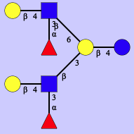
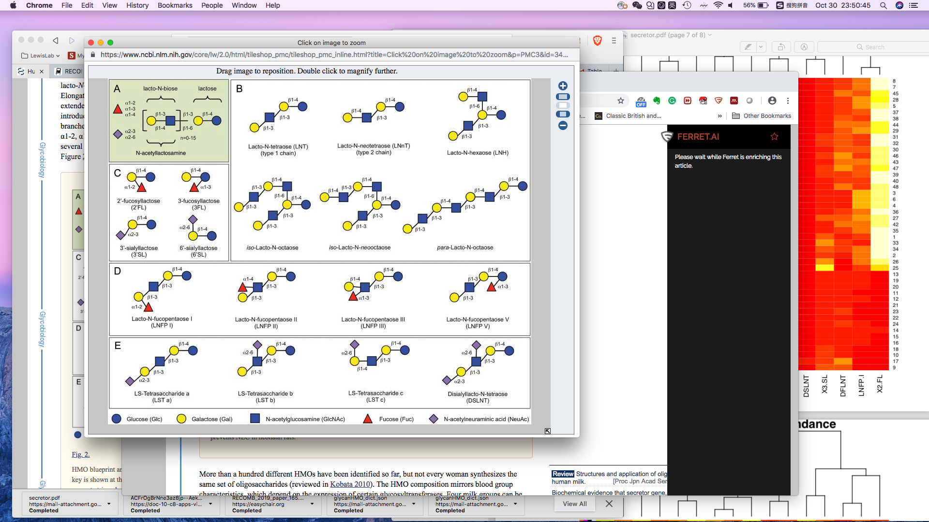
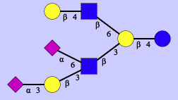
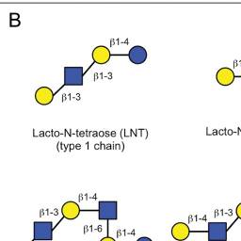
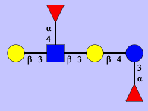
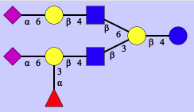
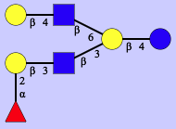
Figure 3 A
Notes:
DFLNH6
DFLNT2
FDSLNH

